Slide 1
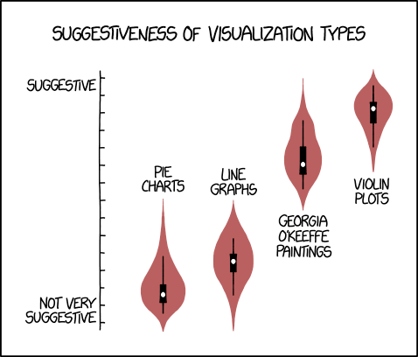
Introduction to Data Visualization Cumulative Distribution Functions, Q-Q Plots Many Distributions At Once, Proportions
Halil Bisgin, Ph.D.
Image: https://imgs.xkcd.com/comics/violin_plots.png

Slide 2
Empirical Cumulative Distribution Functions and Q-Q Plots
Histograms and density plots are intuitive and appealing, but rely on parameters and not direct visualization of the data.
We could plot all points, but unwieldy for large sets.
More accurate and technical, but less intuitive way:
empirical cumulative distribution functions (ECDFs)
quantile-quantile (q-q) plots

Slide 3
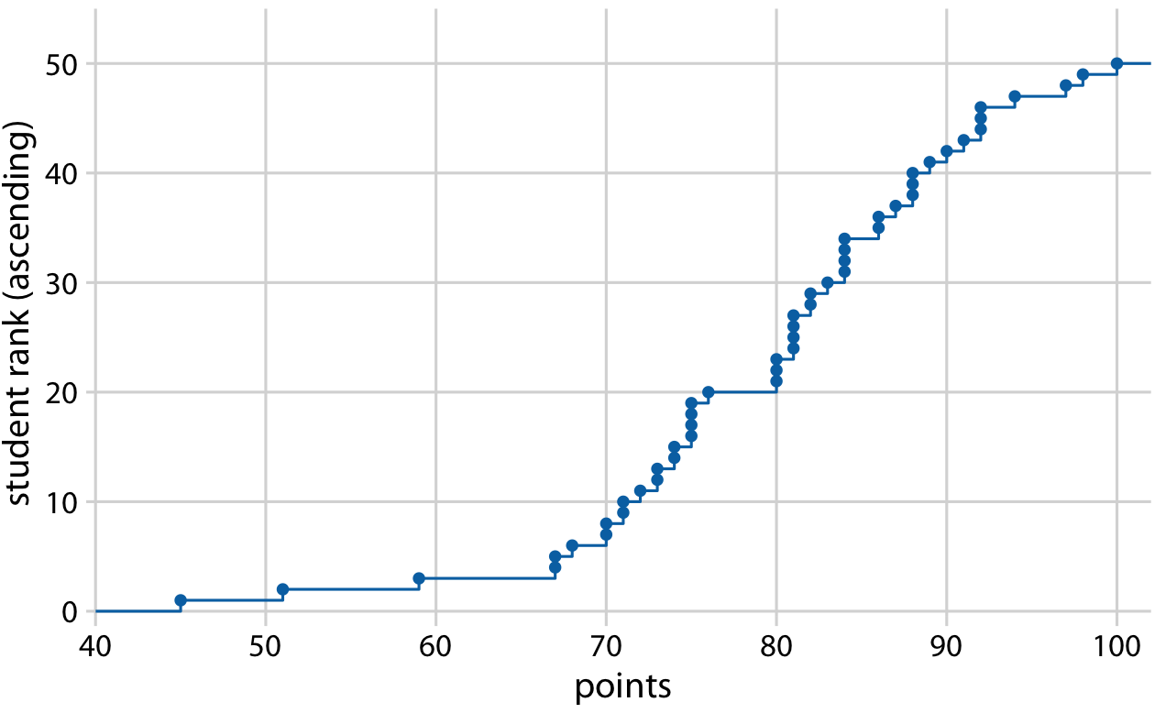
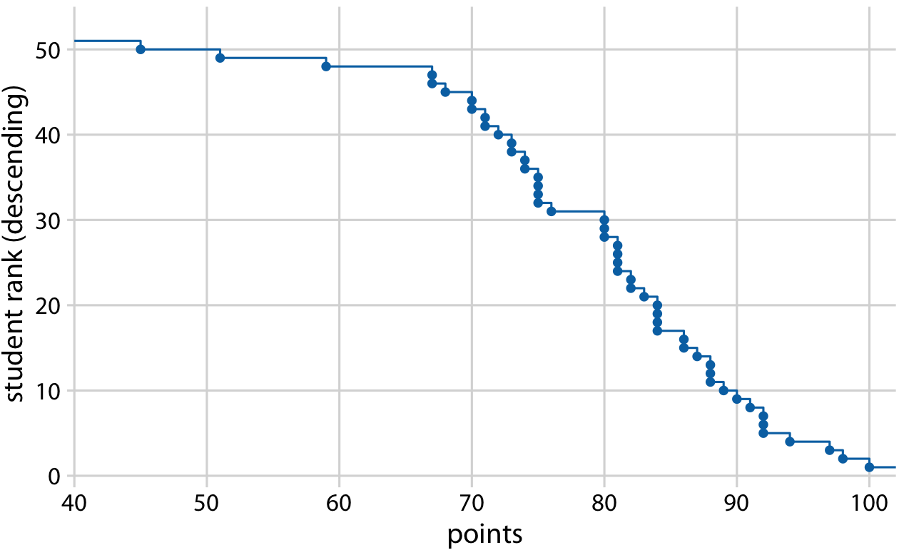
Cumulative Distribution Functions
Empirical cumulative distribution function of student grades for a hypothetical class of 50 students.
Rank all students by the number of points they obtained, in
or
ascending order
descending order
Notes:
a quarter of the students (25%) received less than 75 points. The median point value (corresponding to a cumulative frequency of 0.5) is 81. Approximately 20% of the students received 90 points or more.

Slide 4
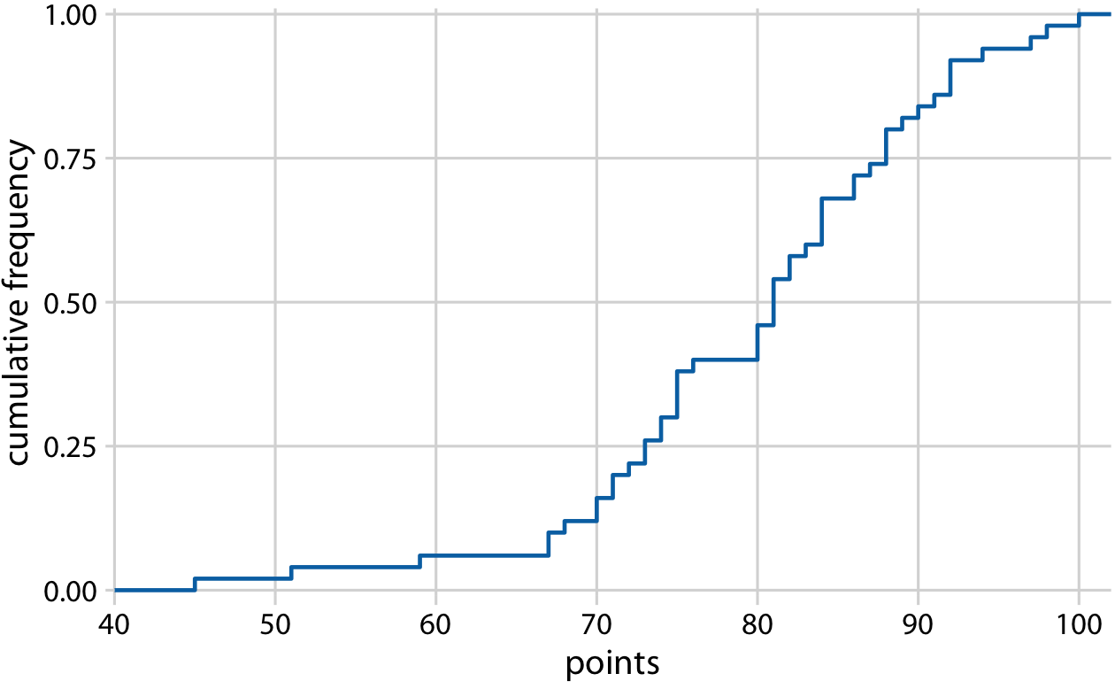
Cumulative Distribution Functions
Normalize the ranks by the maximum rank, so that the y axis represents the cumulative frequency.
20% >= 90
50% = 81
25% < 75
Notes:
a quarter of the students (25%) received less than 75 points. The median point value (corresponding to a cumulative frequency of 0.5) is 81. Approximately 20% of the students received 90 points or more.

Slide 5
Highly Skewed Distributions
Many empirical datasets display highly skewed distributions, in particular with heavy tails to the right, and these distributions can be challenging to visualize.
the number of people living in different cities or counties,
the number of contacts in a social network,
the frequency with which individual words appear in a book
Right tail decays slower than an exponential function, meaning that very large values are not that rare
Power Law
Notes:
consider net worth in the US, which is distributed according to a power law with exponent 2. At any given level of net worth (say, $1 million), people with half that net worth are four times as frequent, and people with twice that net worth are one-fourth as frequent. Importantly, the same relationship holds if we use $10,000 as reference point or if we use $100 million. For this reason, power-law distributions are also called scale-free distributions.

Slide 6
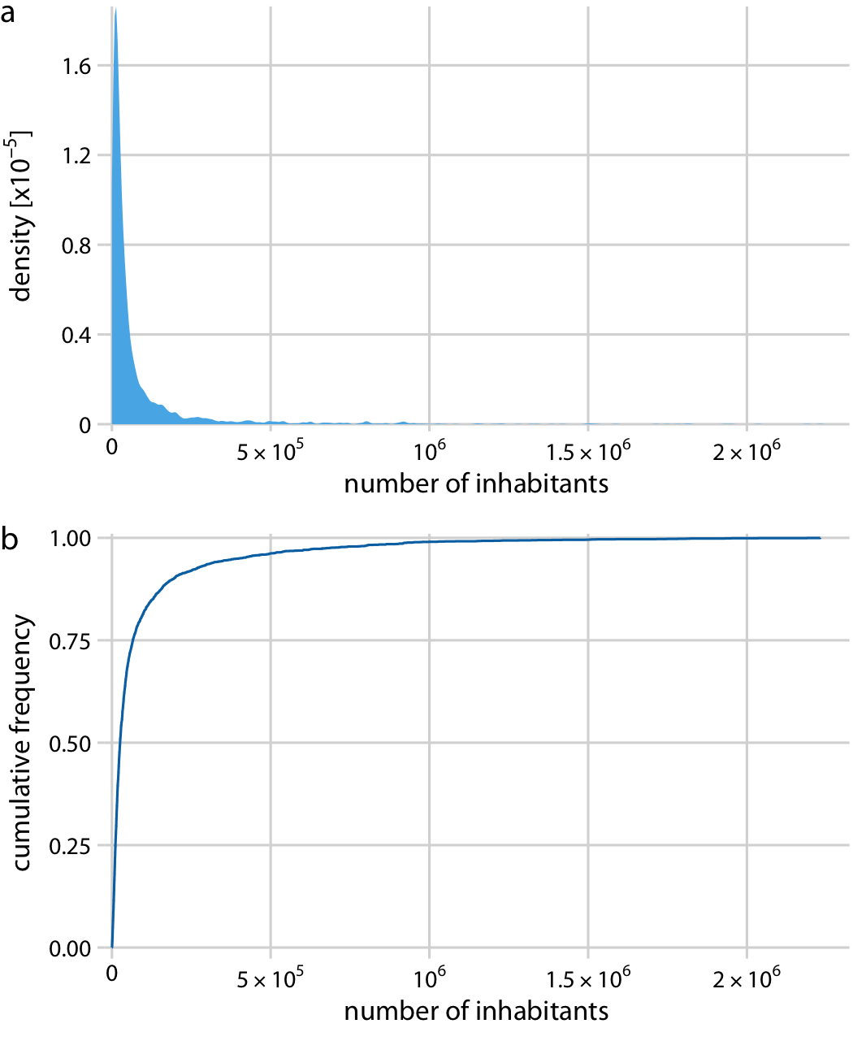

Highly Skewed Distributions
The number of people living in different US counties according to the 2010 US Census.
sharp peak at 0
rapid rise near 0
Notes:
Even though most counties have relatively small numbers of inhabitants (the median is 25,857), a few counties have extremely large numbers of inhabitants (e.g., Los Angeles County, with 9,818,605 inhabitants).

Slide 7
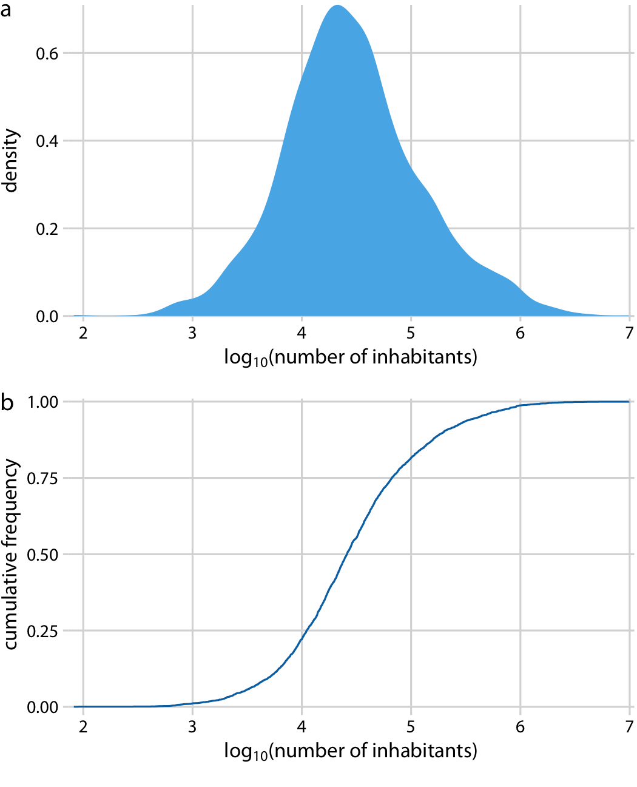
Highly Skewed Distributions
Log transformation offers more interpretable charts.
→→→→

Slide 8
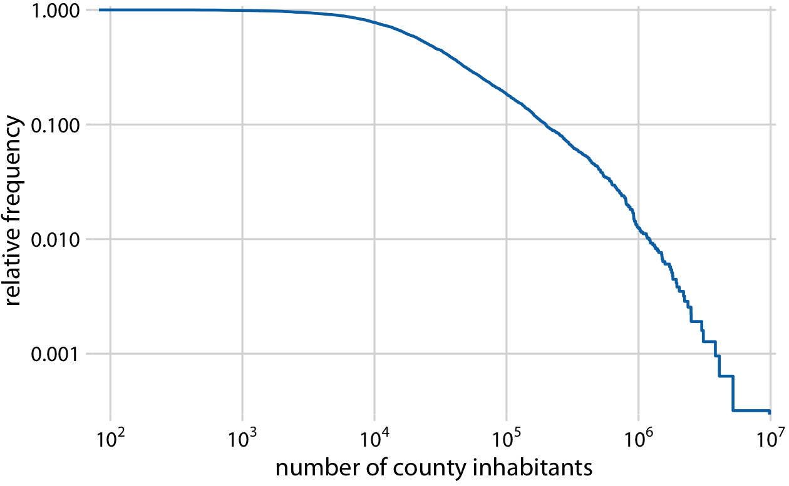
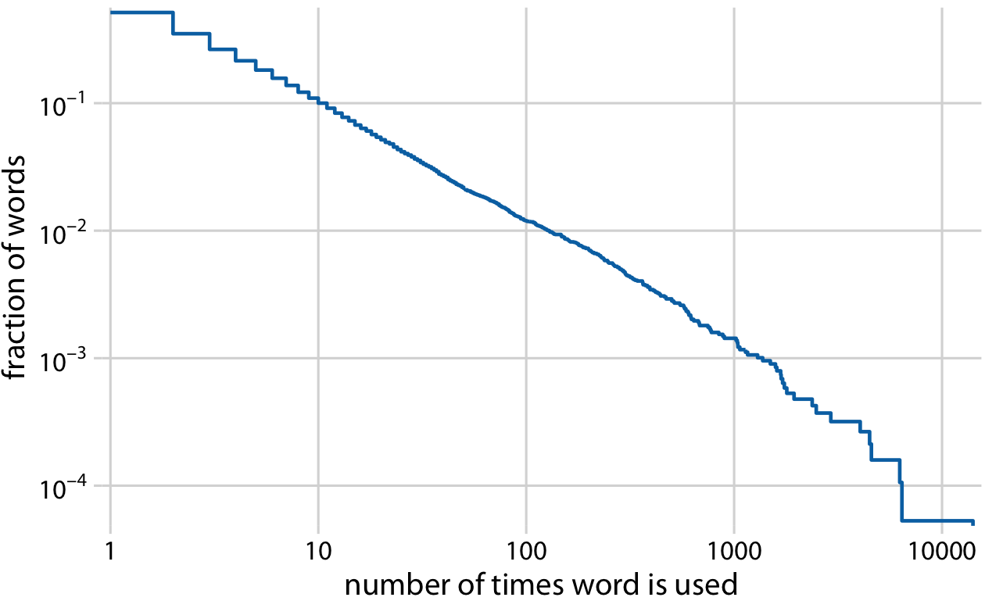
Highly Skewed Distributions
To comply with power law, log-log of the descending ECD should be a straight line.

Slide 9
Quantile-Quantile Plots
Quantile-quantile (q-q) plots are useful when we want to determine to what extent the observed data points follow a given distribution.
Visualizes the relationship between ranks and actual values.
We don’t plot the ranks directly; rather, we use them to predict where a given data point would fall if the data were distributed according to a specified reference distribution.

Slide 10
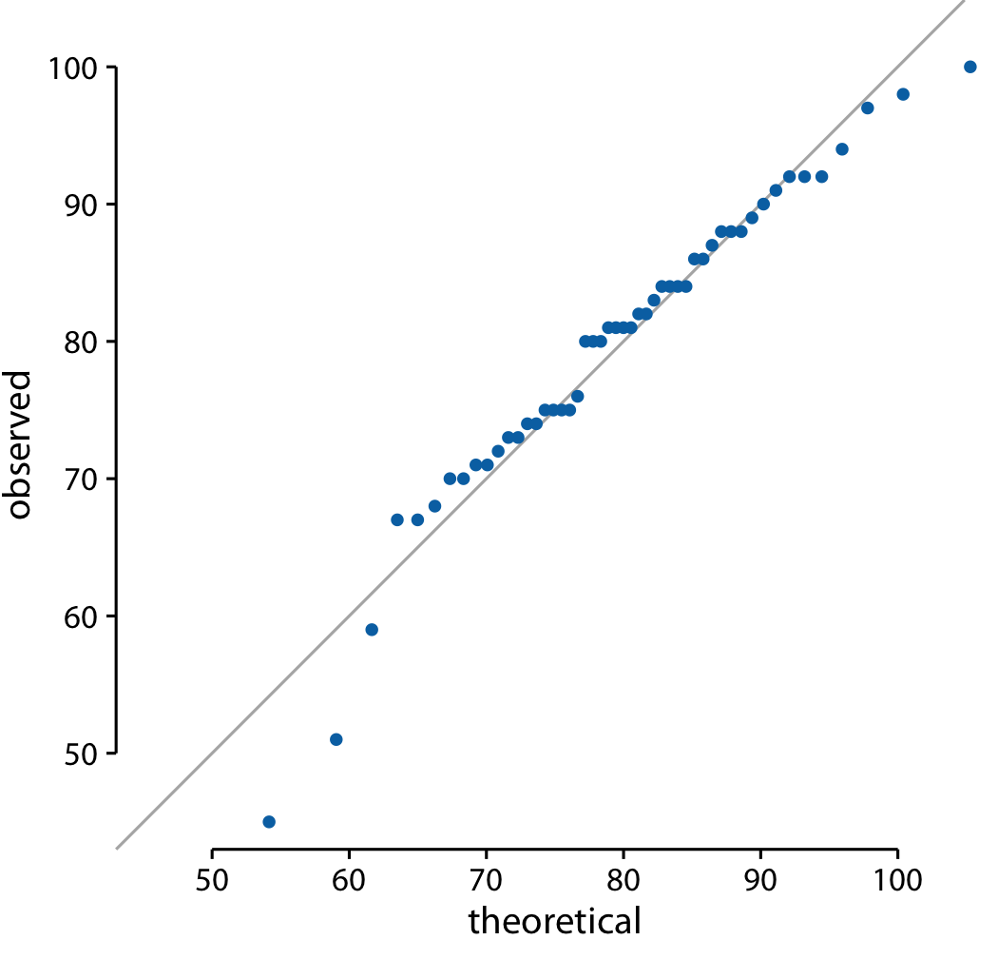
Quantile-Quantile Plots
Suppose there are values with (μ=10, σ=3) and compare with normal distribution.
Depending on theoretical percentiles, we determine the positions for the values.
Then we plot their observed
and theoretical positions.
The more the points
on the diagonal line,
the more the
distributions agree.

Slide 11
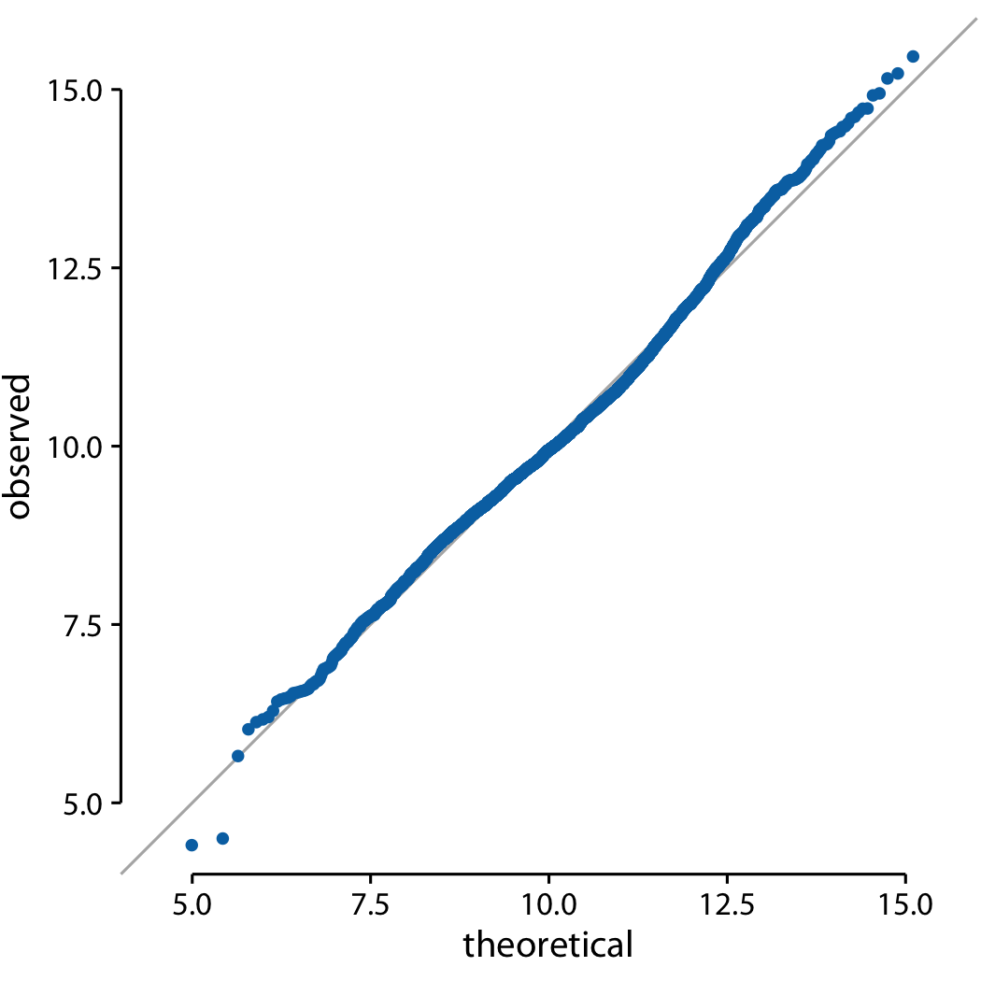
Quantile-Quantile Plots
Do the population counts in US counties follow a log-normal distribution.

Slide 12
Visualizing Many Distributions at Once
It is helpful to think in terms of the response variable and one or more grouping variables.
Response variable is the one whose distributions we want to show.
The grouping variables define subsets of the data with distinct distributions of the response variable.
For temperature distributions across months, the response variable is the temperature and the grouping variable is the month.
The response variable can be along the vertical axis, and the horizontal axis.

Slide 13
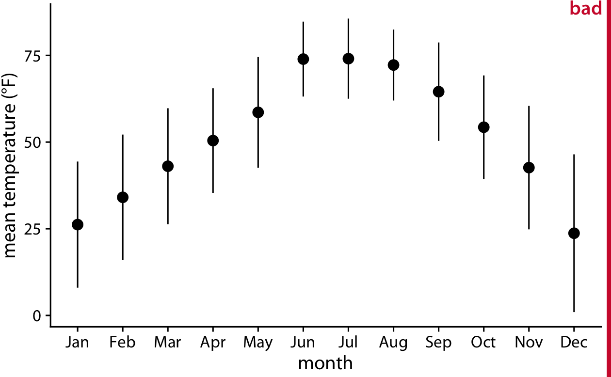
Along the Vertical Axis
The simplest approach to showing many distributions at once is to show their mean or median as points, with some indication of the variation around the mean or median shown by error bars.

Slide 14
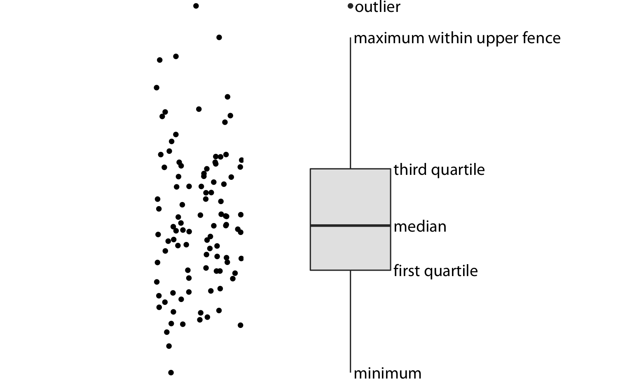
Along the Vertical Axis-Box Plot
A boxplot divides the data into quartiles and visualizes them in a standardized manner.
The vertical lines extending upwards and downwards from the box are called whiskers.
The distances of 1.5 times the height of the box in either direction are called the upper and lower fences.

Slide 15
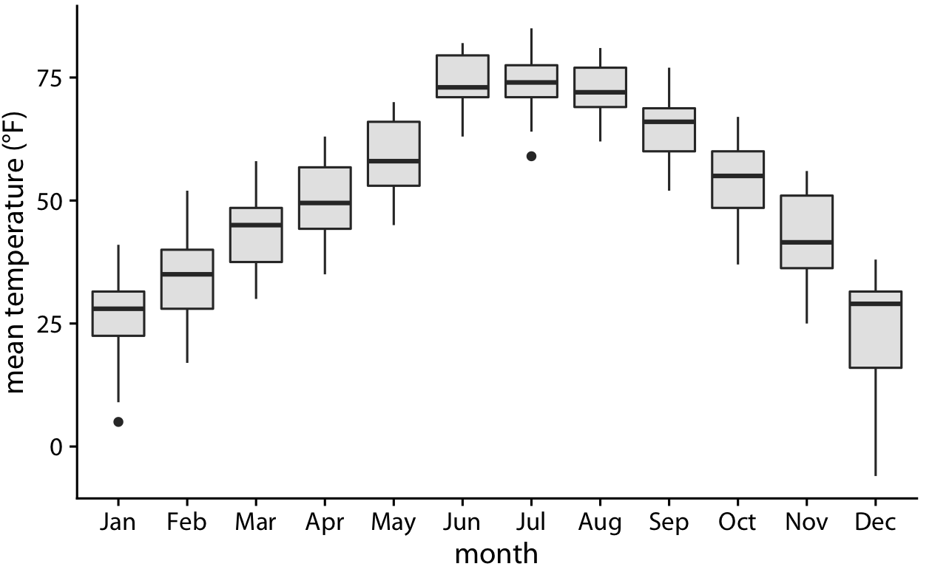
Along the Vertical Axis-Box Plot
Temperature is highly skewed in December (most days are moderately cold and a few are extremely cold) and not very skewed at all in some other months, such as in July.
The Lincoln (NB) temperature data, using boxplots.

Slide 16
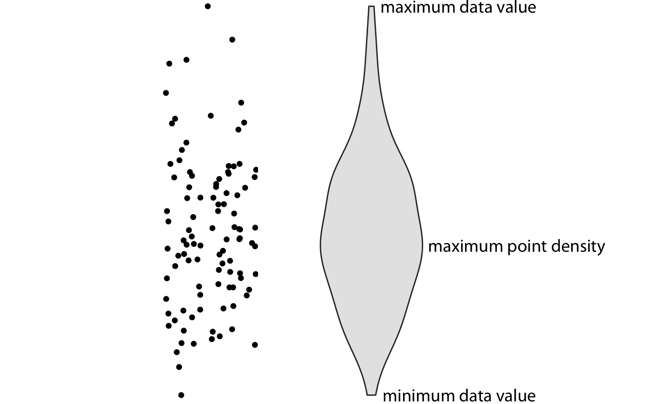
Along the Vertical Axis-Violin Plot
Violin plots will accurately represent bimodal data.
The width of the violin represents the point density at that y value.
It is a density estimate rotated by 90 degrees, mirrored, and therefore symmetric.
Violins begin and end at the min and max data values, respectively.
The thickest part of the violin corresponds to the highest point density in the dataset.
Notes:
Before using violins to visualize distributions, verify that you have sufficiently many data points in each group to justify showing the point densities as smooth lines.

Slide 17
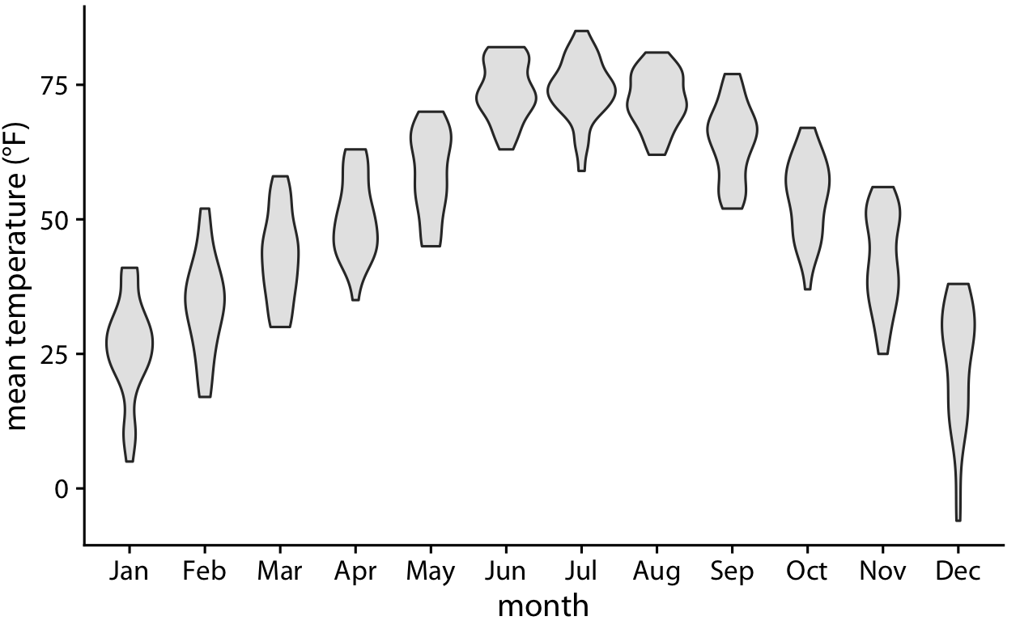
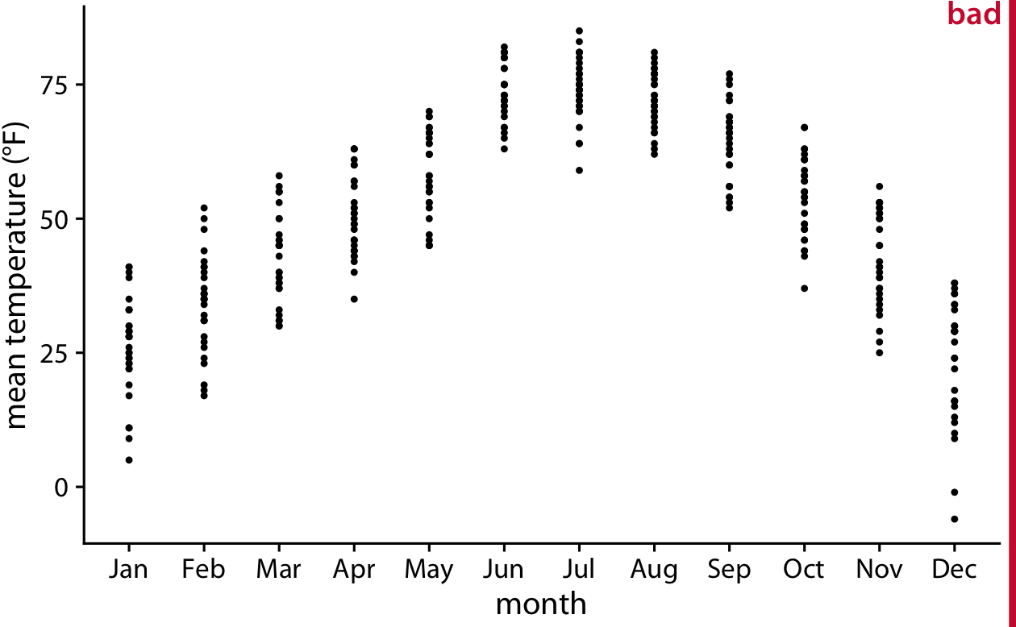
Along the Vertical Axis-Strip Chart
Violin plots are derived from density estimates, they have similar shortcomings.
They can generate the appearance that there is data where none exists, or that the dataset is very dense when actually it is quite sparse.
Strip chart overcomes this problem, but overplotting?

Slide 18
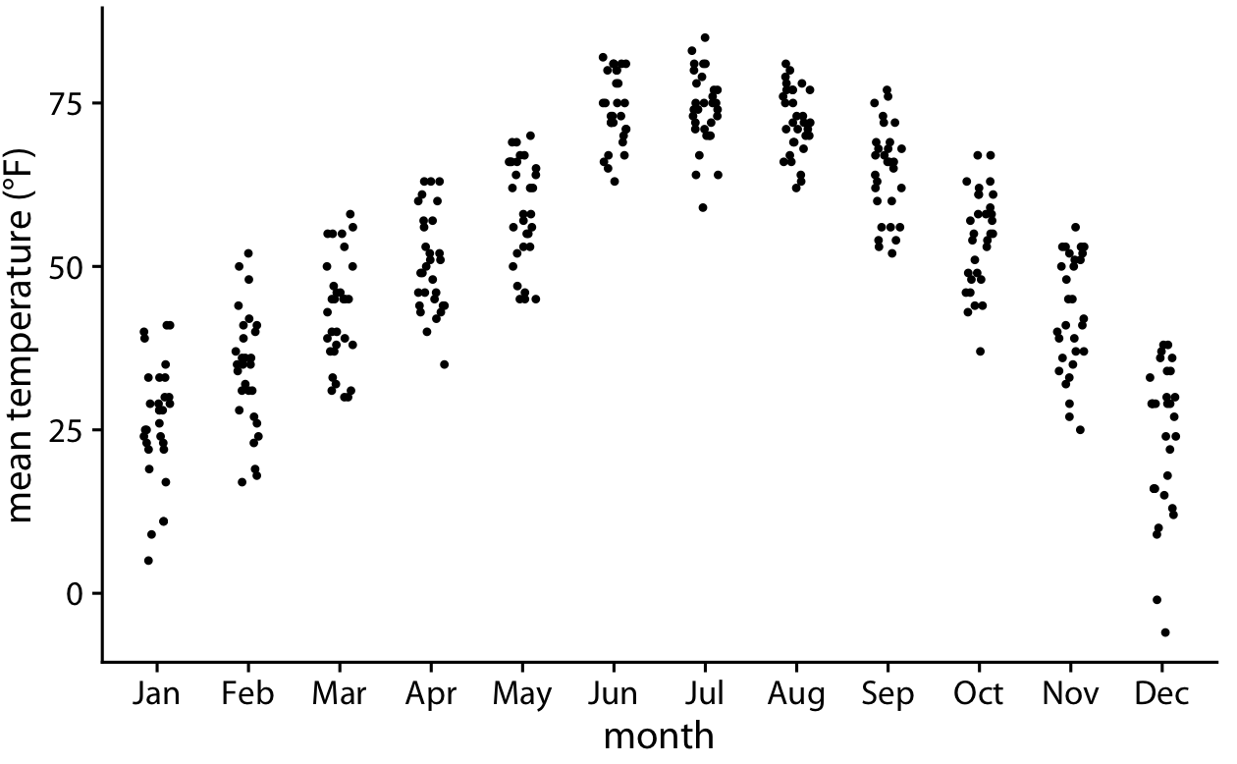
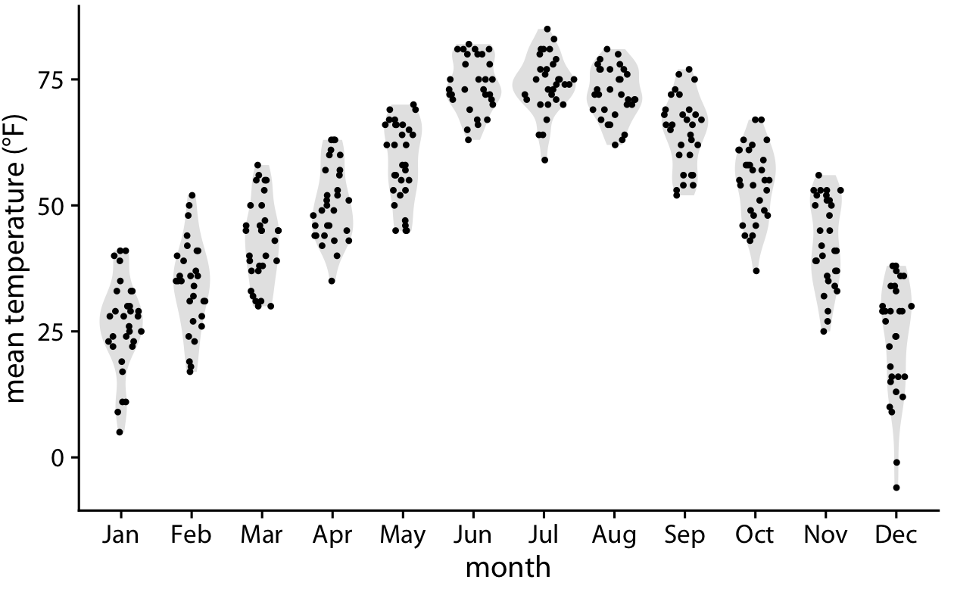
Along the Vertical Axis-Sina Plot
We can spread out points by adding noise, jitter.
we can combine the best of both worlds by spreading out the dots in proportion to the point density at a given y coordinate, sina plot

Slide 19
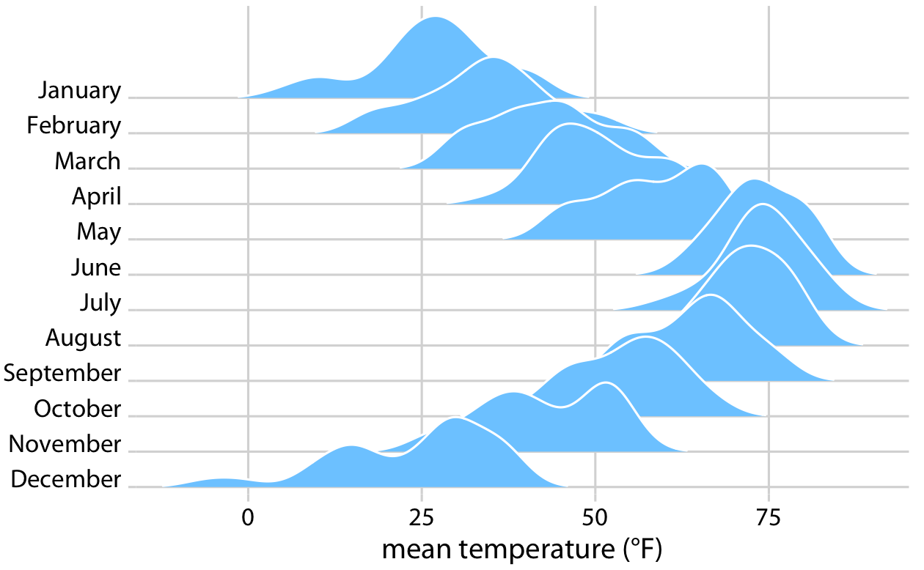
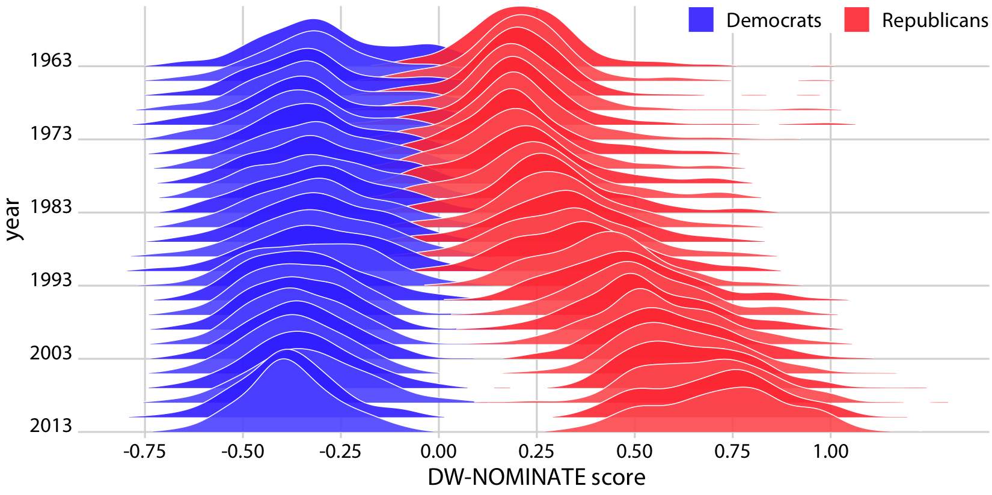
Along the Horizantal Axis-Ridgeline
The standard ridgeline plot uses density estimates.
Quite closely related to the violin plot, but frequently evokes a more intuitive understanding of the data.
For example, the two clusters of temperatures around 35 degrees and 50 degrees Fahrenheit in November are much more obvious (1).
work well if we want to compare two trends over time (2)
1
2

Slide 20
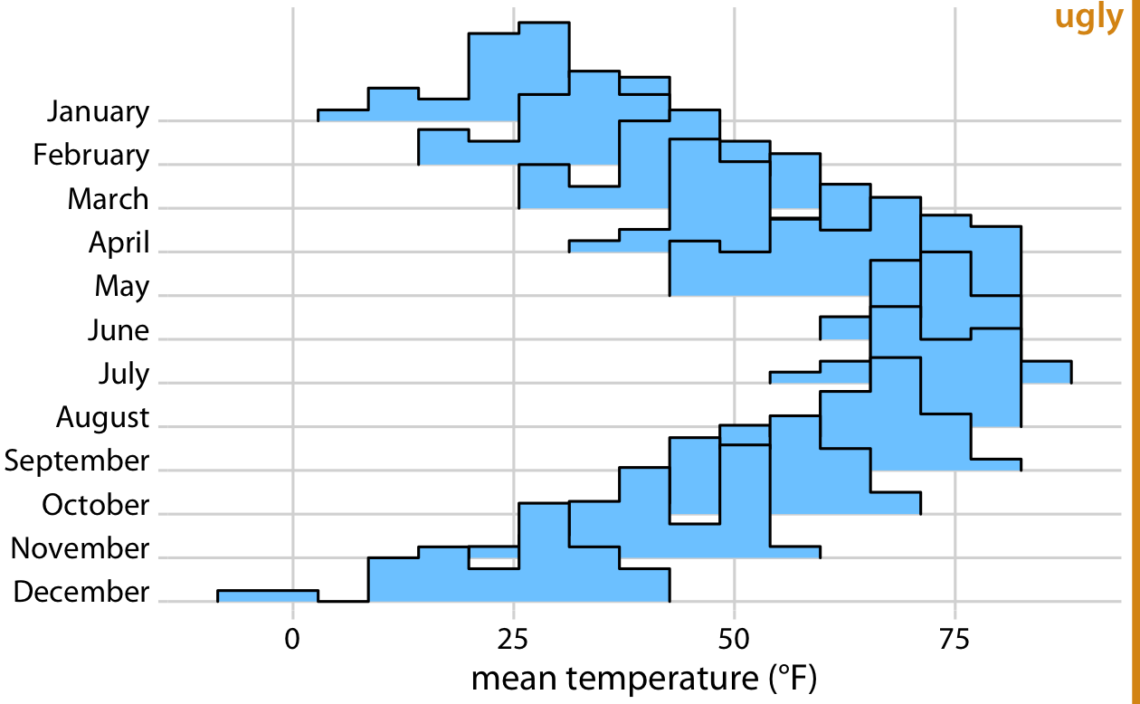
Along the Horizantal Axis-Histograms
In principle, we can use histograms instead of density plots in a ridgeline visualization. However, the resulting figures often don’t look very good
The bars from different histograms align with each other in confusing ways.

Slide 21
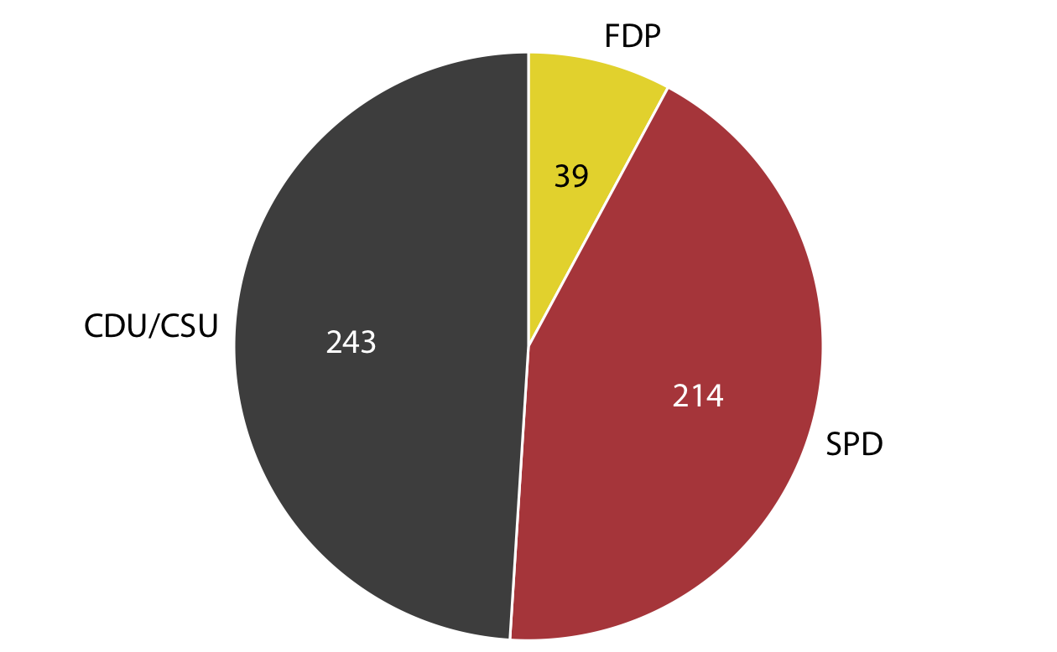
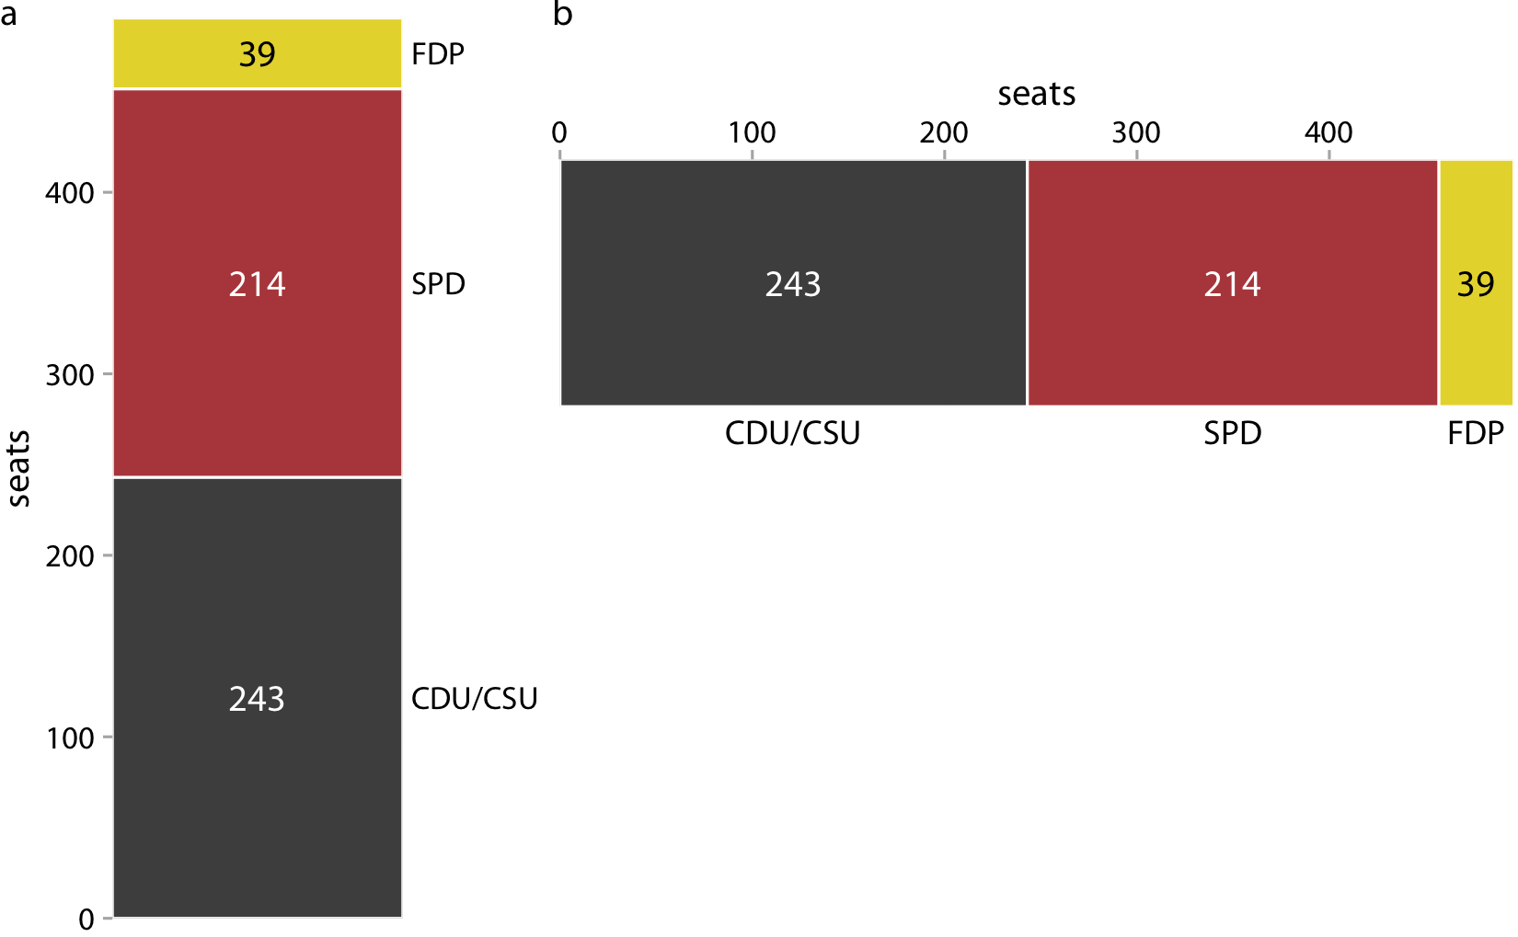
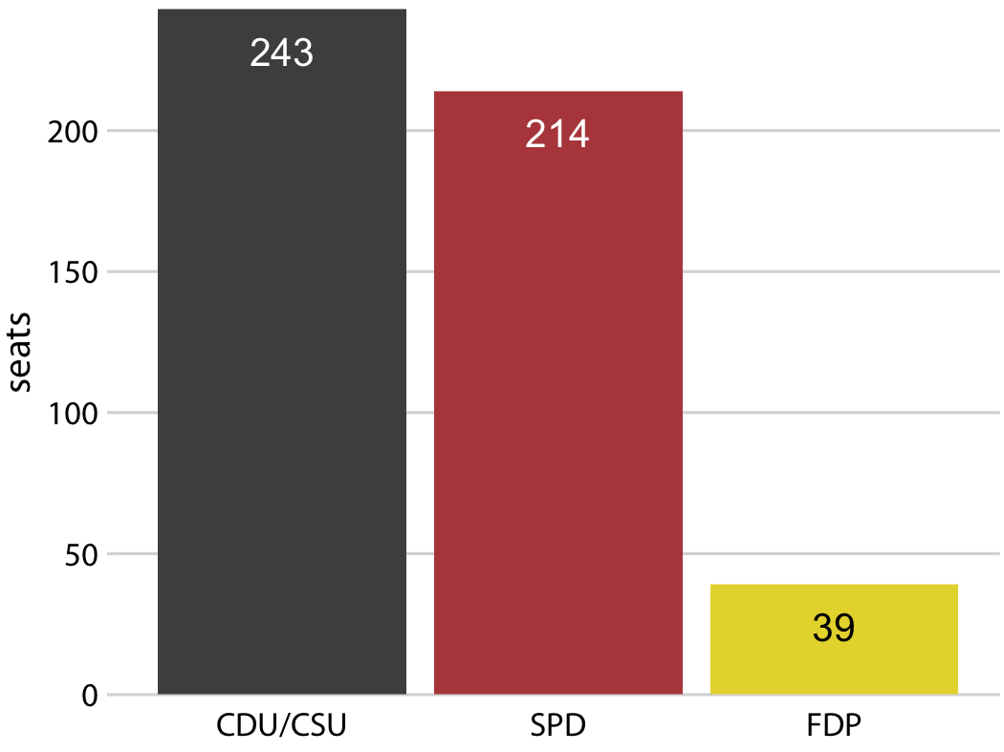
Visualizing Proportions
Party composition of the eighth German Bundestag, 1976–1980
OK

Slide 22
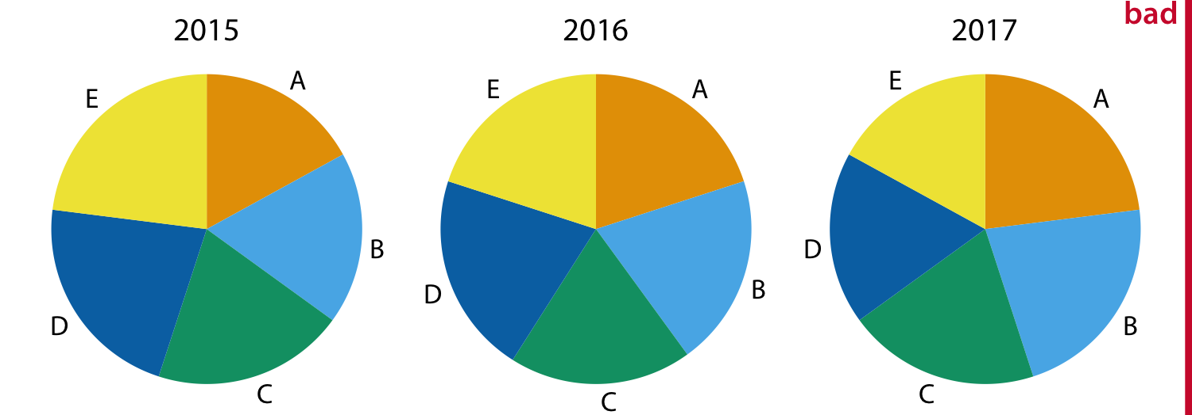
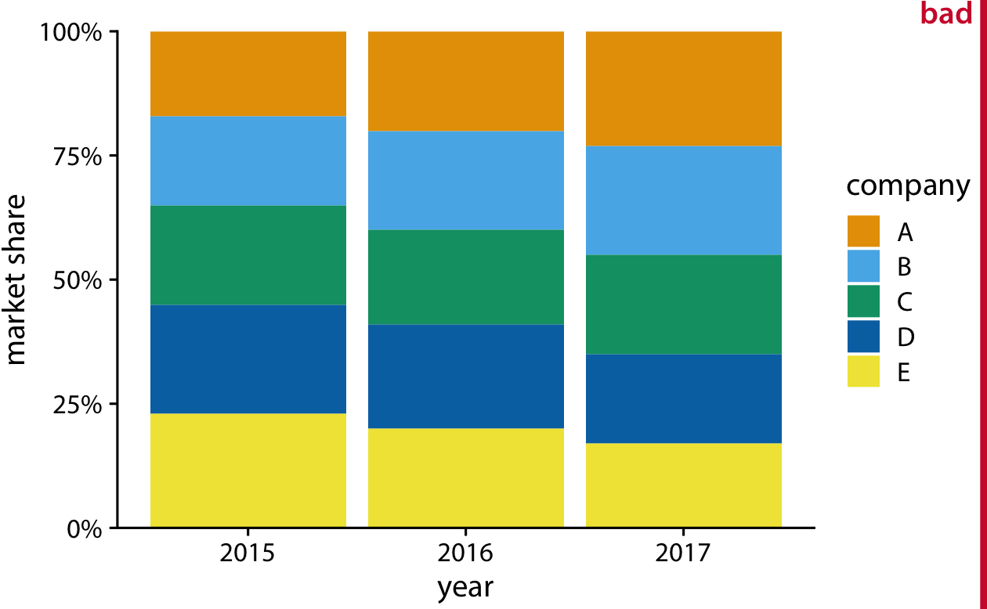
Visualizing Proportions
Market shares
Hard to differentiate pie charts
Hard to follow B, C, and D

Slide 23
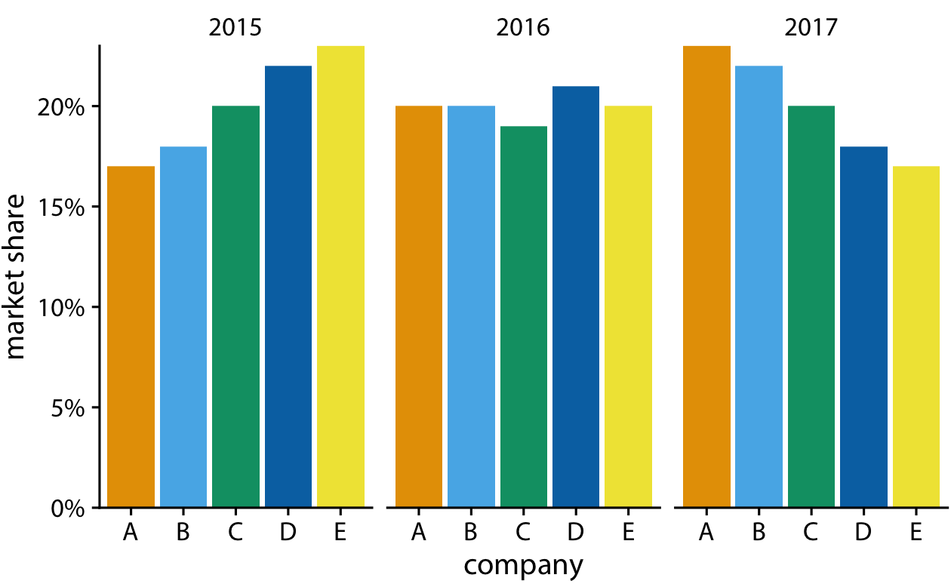
Visualizing Proportions

Slide 24
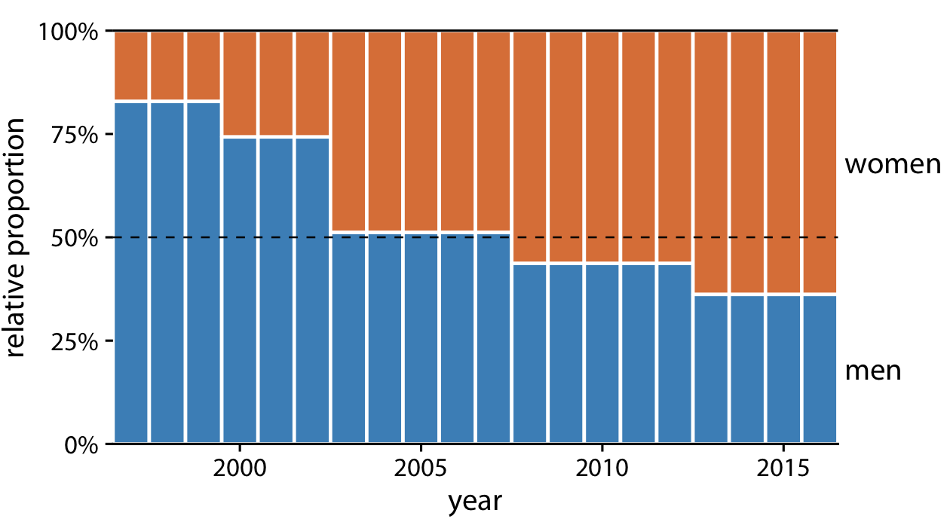
Visualizing Proportions
The problem of shifting internal bars disappears if there are only two bars in each stack.
Proportions are clear

Slide 25
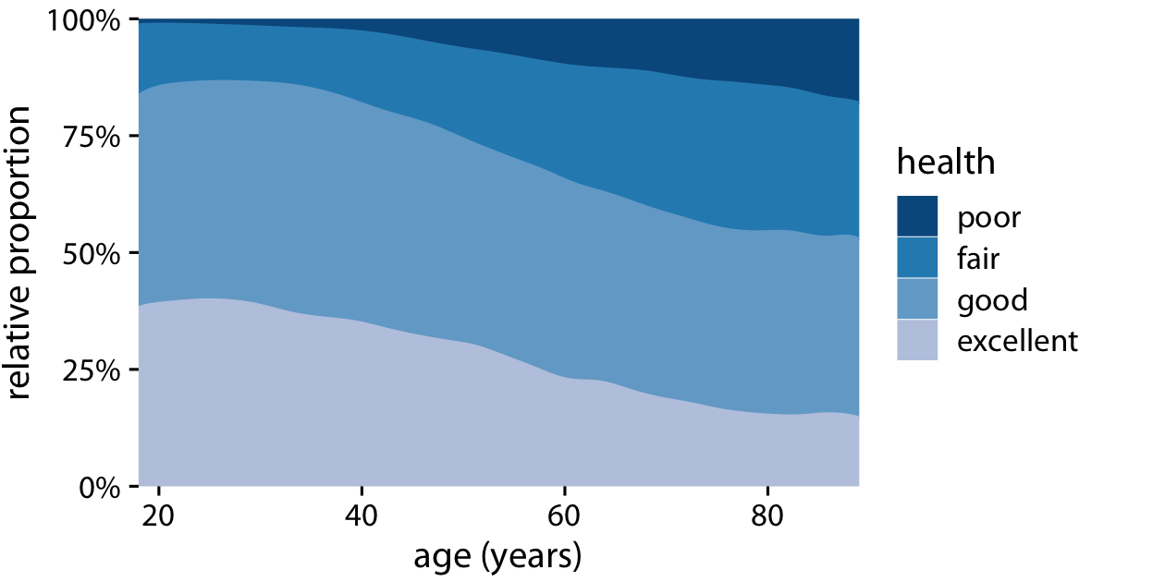
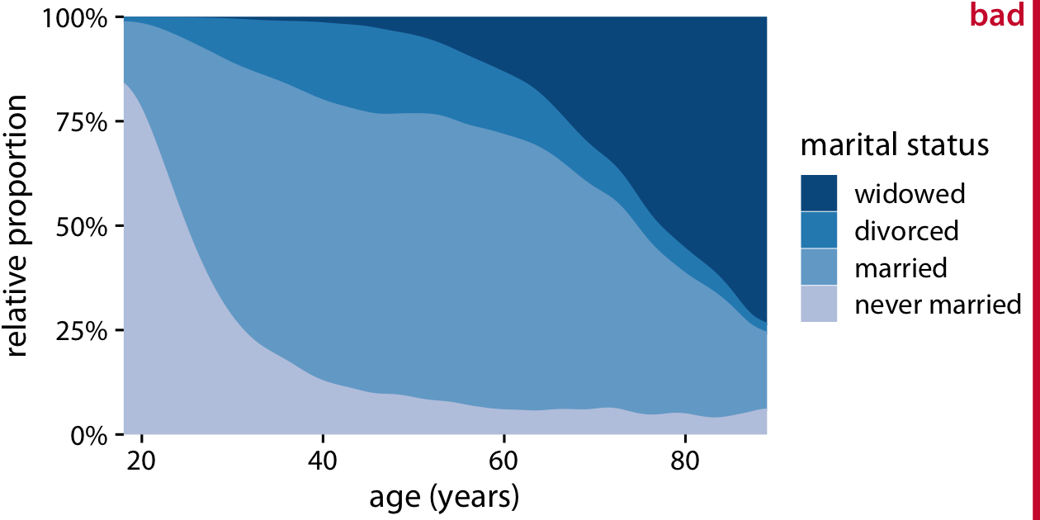
Visualizing Proportions
Stack densities may (not) work
Health status by age
Marital status by age

Slide 26
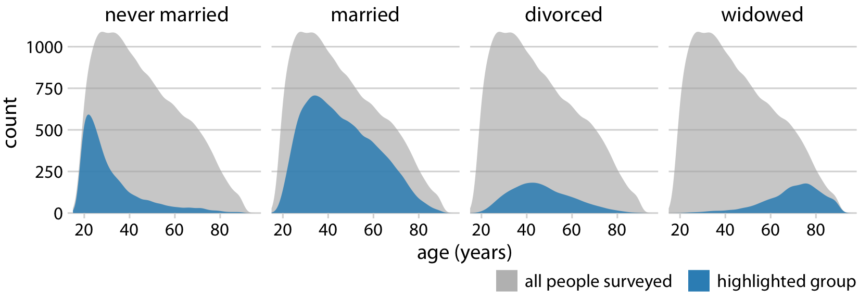
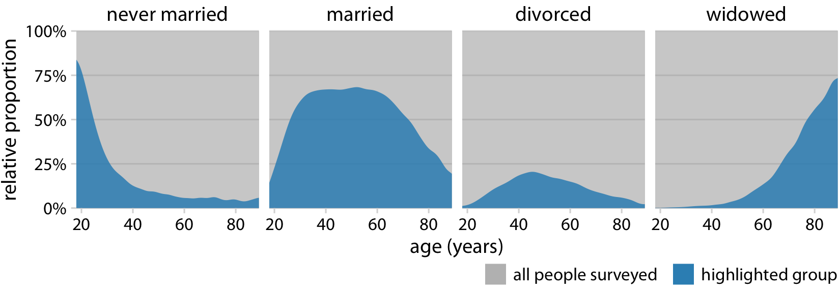
Visualizing Proportions
Better, but still not easy to determine relative proportions
Much better

Slide 27
Nested Proportions
We may want to drill down further and break down a dataset by multiple categorical variables at once.
We could be interested in the proportions of seats by party and by the gender of the representatives.

Slide 28
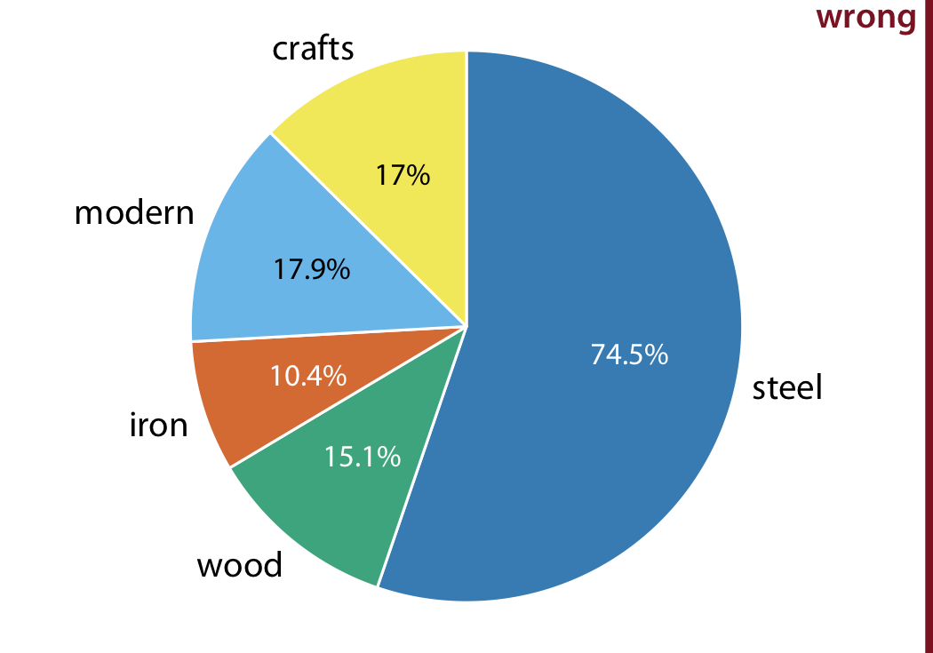
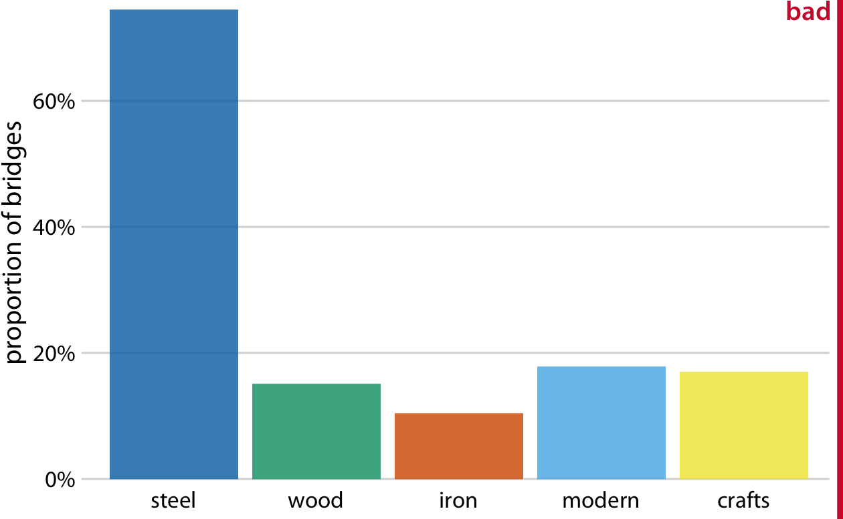
Nested Proportions Gone Wrong
A dataset of 106 bridges in Pittsburgh.
material from which they are constructed (steel, iron, or wood),
based on the year of erection, bridges are grouped into distinct categories, such as crafts and modern.
On which river?
Sum exceeds 100% due to double count
It does not clearly indicate the overlap

Slide 29
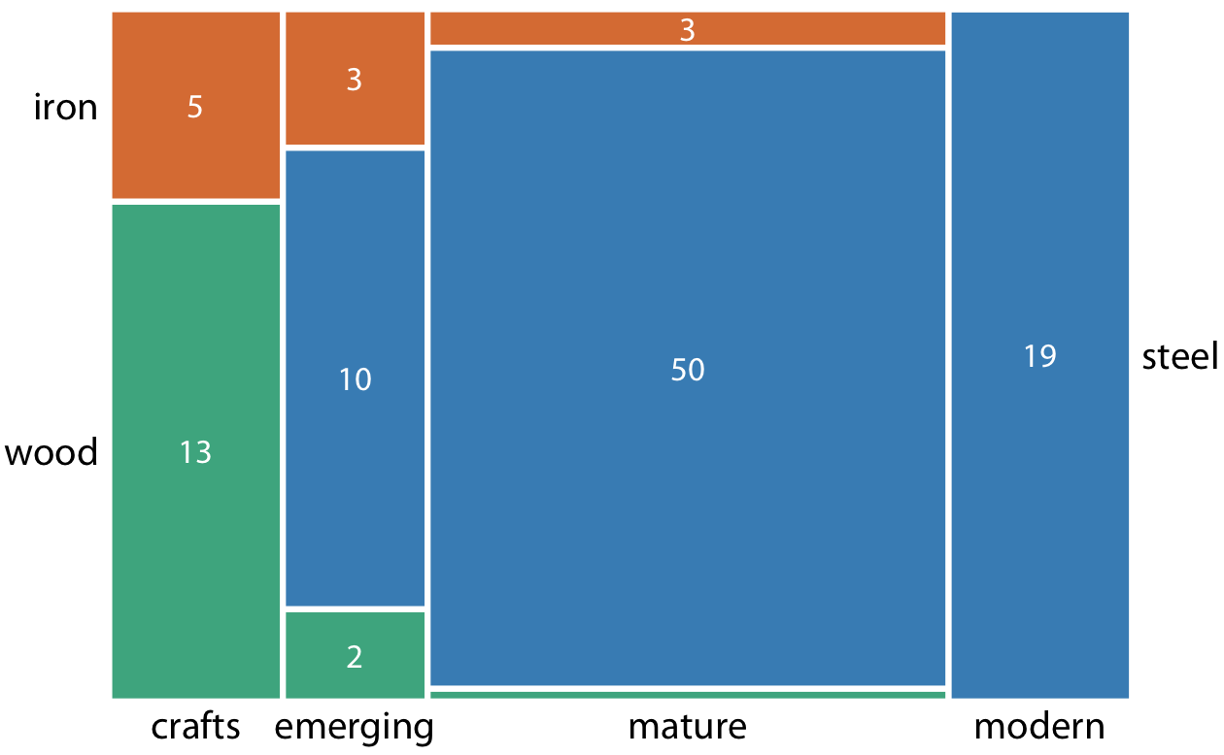
Nested Proportions-Mosaic Plot
When there are overlapping categories, it is best to show explicitly how they relate to each other.

Slide 30
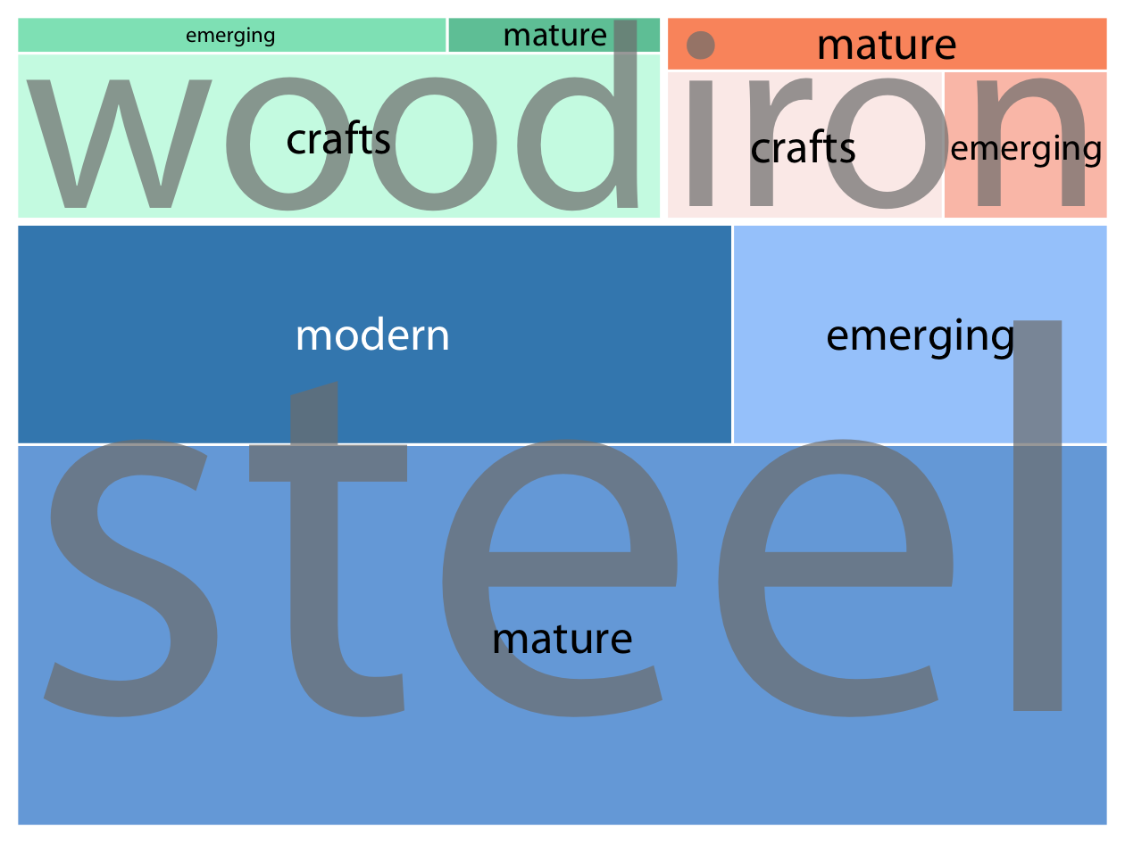
Nested Proportions-Treemap Plot
Shows the counts for every possible combination

Slide 31
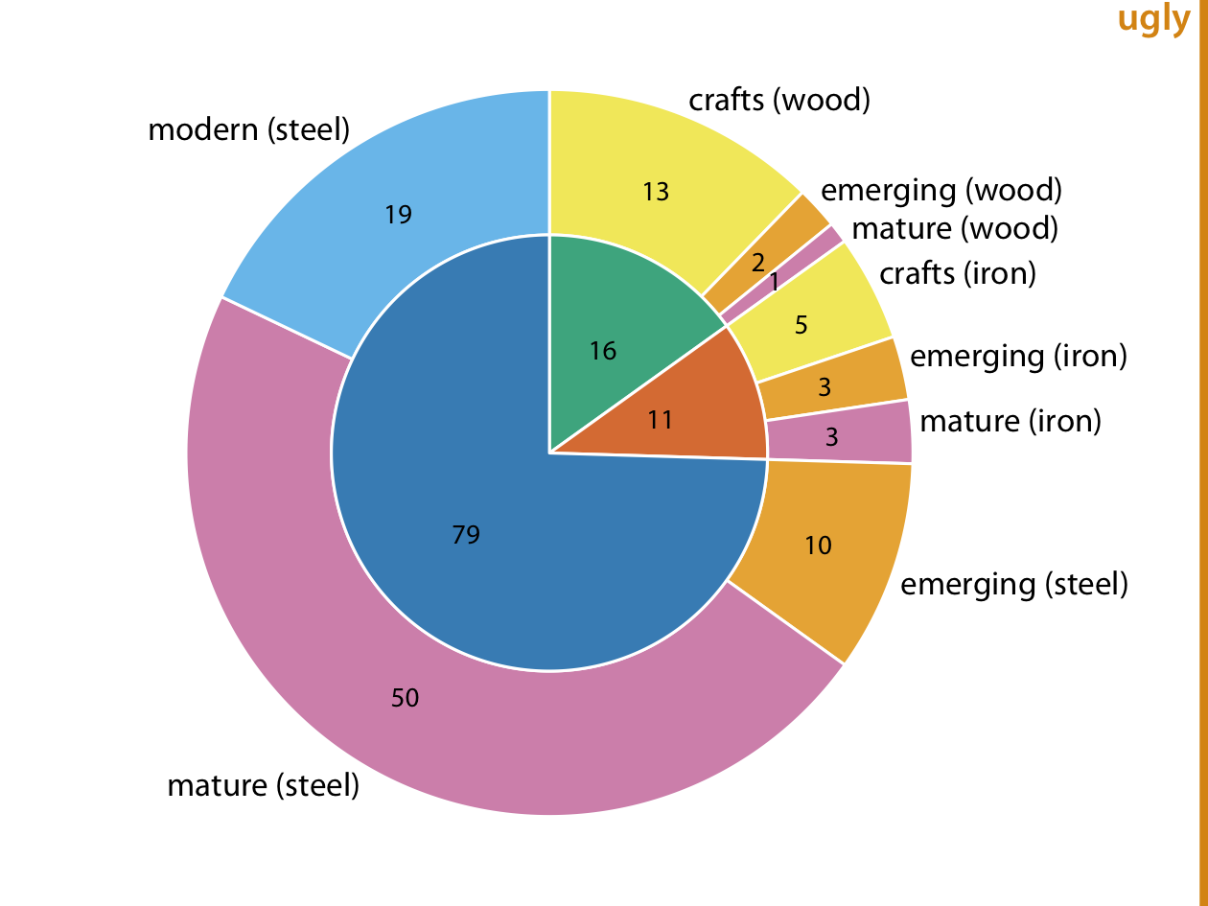
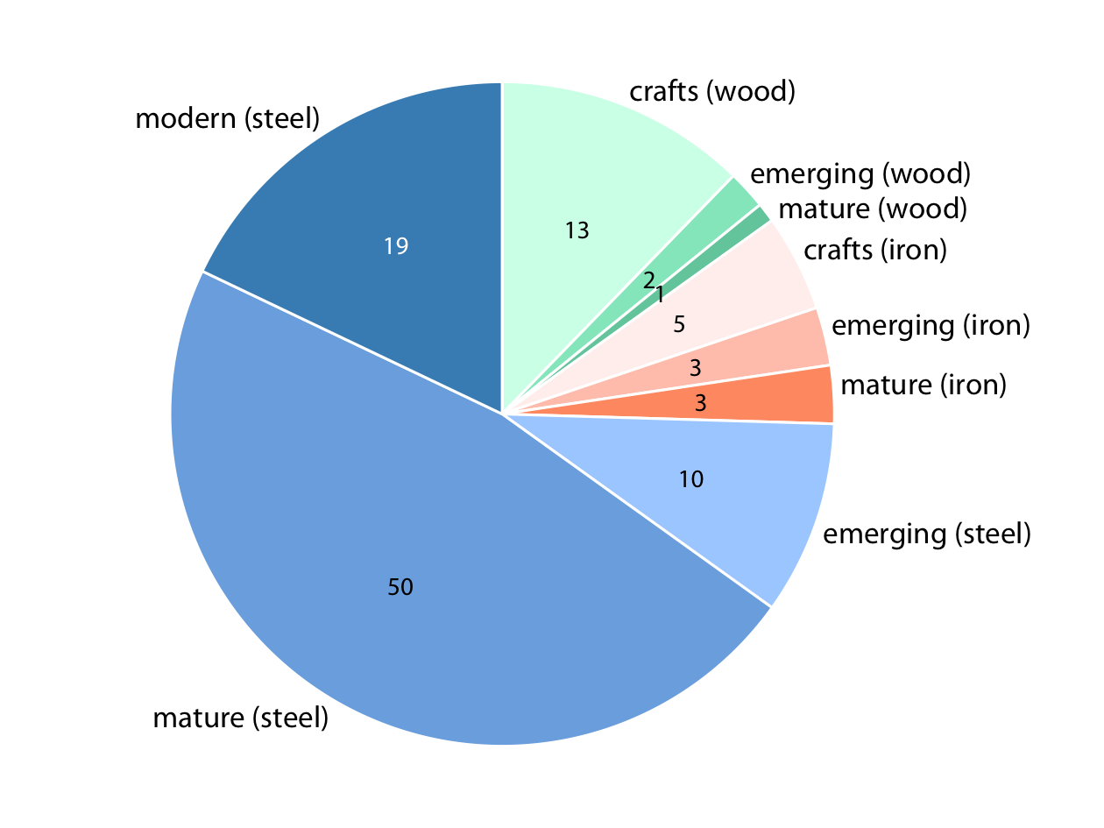
Nested Proportions-Nested Pies

Slide 32
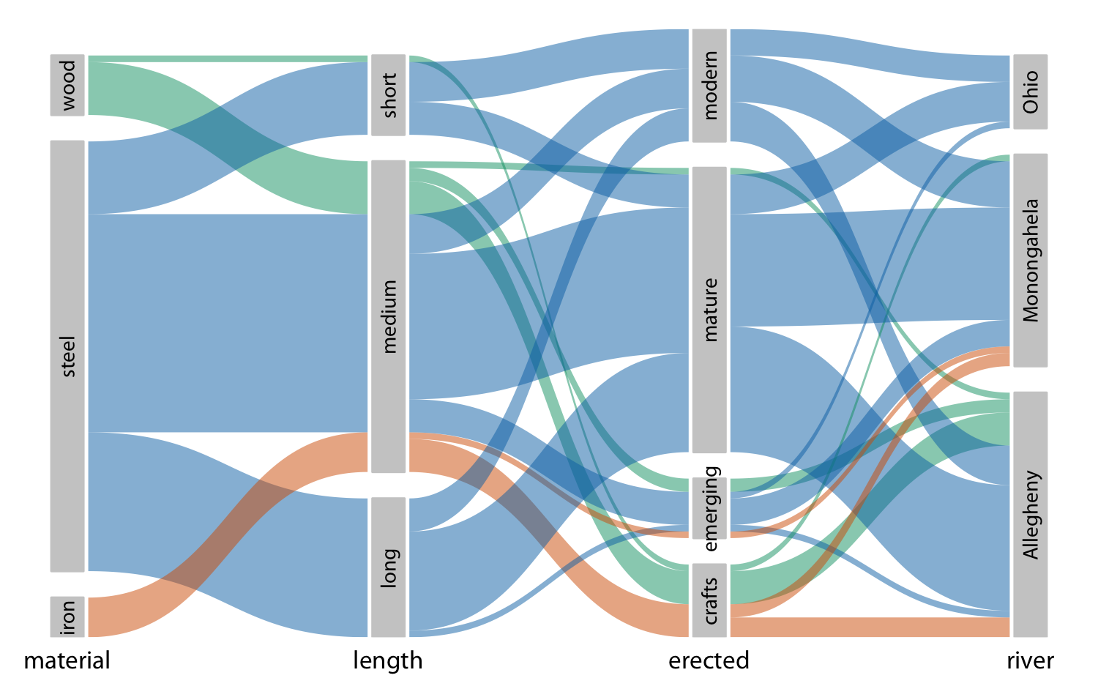
Nested Proportions-Parallel Sets
When more than two categorical variables, parallel sets plot can offer a less crowded view.
It shows how the total dataset breaks down by each individual categorical variable by using shaded bands.

